Slide 1

Decoding the AI Revolution: A Primer on Artificial Intelligence & Prompt Engineering
The AI revolution impacts nearly every facet of our lives. This presentation demystifies AI and prompt engineering, providing a detailed overview of key concepts, importance, applications, and future scope.

Slide 2
What is AI?
Human Intelligence Simulation
Achieved Through Data
AI simulates human intelligence in machines. It encompasses learning, reasoning, problem-solving, perception, and language understanding.
AI is achieved through machine learning, deep learning, and neural networks. It involves data-driven statistical modeling for computers to problem-solve without explicit instructions.

Slide 3

Prompt Engineering: The Art of Guiding AI
Definition
Crafting effective prompts elicits desired responses from AI models.
Techniques
Includes instruction, few-shot, and chain-of-thought prompting.
Importance
Crucial for optimizing AI performance and accuracy. Poorly designed prompts lead to irrelevant or biased outputs.

Slide 4

AI's Importance: Transforming Industries
Automation
Automating repetitive tasks, increasing efficiency, and reducing costs across all sectors.
Data Analysis
Analyzing large datasets to identify trends, patterns, and valuable insights rapidly.
Decision-Making
Enhancing decision-making processes with accurate, data-driven recommendations.
Personalization
Delivering tailored experiences to customers based on individual preferences.

Slide 5





Applications Across Sectors
Healthcare
Finance
Manufacturing
AI-powered diagnostics, personalized treatments, and drug discovery acceleration.
Fraud detection, algorithmic trading, and advanced risk assessment tools.
Predictive maintenance, quality control, and optimized supply chains.
Transportation
Autonomous vehicles, smart traffic management, and route optimization.

Slide 6




Key Concepts: Machine Learning (ML)
Definition
Types
Algorithms that learn from data without explicit programming.
1
2
Supervised, unsupervised, and reinforcement learning methods.
Real-world Example
Algorithms
4
3
Netflix uses ML to predict movie preferences effectively.
Includes linear regression, decision trees, and neural networks.

Slide 7
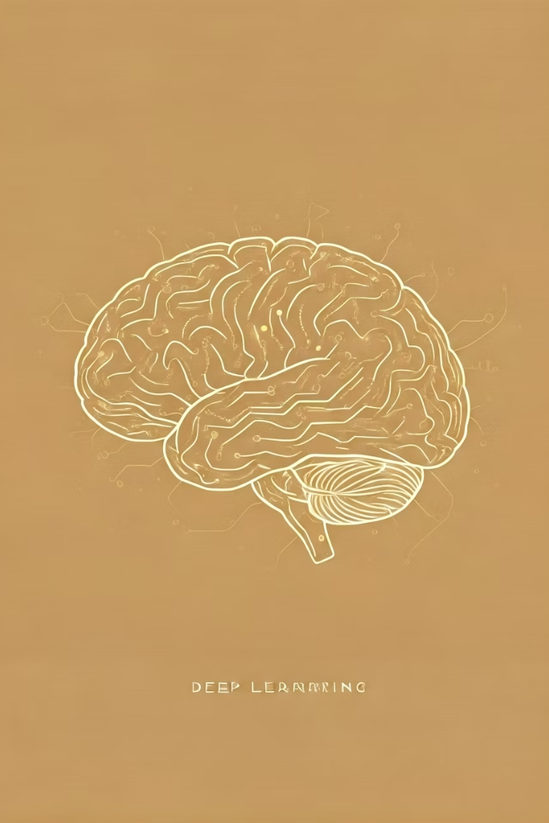
Key Concepts: Deep Learning (DL)
1
Definition
Neural networks with multiple layers analyze data hierarchically.
2
Inspiration
Inspired by the structure and function of the human brain.
3
Breakthroughs
Enables advancements in image recognition, NLP, and speech recognition.
4
Example
Image recognition accuracy surged from 72% to 96% (2010-2024).

Slide 8





Key Concepts: Natural Language Processing (NLP)
Understanding Language
Enables computers to understand and interpret human language.
Generating Language
Allows computers to generate human-like text and speech.
Key Components
Language modeling, text classification, and sentiment analysis.
Real-world Use
Google Translate processes over 100 billion words daily.

Slide 9




The Future Scope of AI
AI-Driven Innovation
1
Fueling breakthroughs in science, engineering, and business.
Human-AI Collaboration
2
Combining human expertise with AI capabilities for enhanced outcomes.
AI Democratization
3
Making AI tools and resources accessible to everyone globally.
Ethical AI & Regulation
4
Ensuring fairness, transparency, and accountability in AI systems.

Slide 10

Conclusion: Embracing the AI Era
AI and prompt engineering are revolutionizing industries. They are creating new opportunities across all sectors. It is essential to understand the basics and stay informed about the latest developments. The future is AI.

